Slide 1
Model Selection and Regularization
Session 09-10

Slide 2
Learning Outcome
LO 1: Explain the fundamental of machine learning concept
LO 2: Interpret the distribution of dataset using regression method
LO 3: Experiment classification and clustering algorithm from given dataset

Slide 3
Outline
Overfitting and Underfitting
Cross Validation
Regularization

Slide 4
Overfitting and Underfitting

Slide 5
Overfitting and Underfitting
Overfitting and Underfitting are two crucial concepts in machine learning and are the prevalent causes for the poor performance of a machine learning model.
Overfitting happens when a model performs very well for training data but has poor performance with test data (new data).
the machine learning model learns the details and noise in the training data such that it negatively affects the performance of the model on test data
Overfitting can happen due to low bias and high variance.

Slide 6
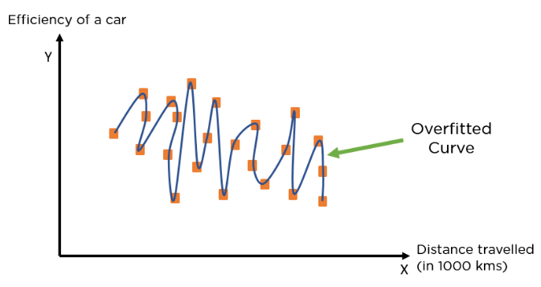
Overfitting and Underfitting
Overfitting

Slide 7
Overfitting and Underfitting
Overfitting
Reasons for Overfitting
Data used for training is not cleaned and contains noise (garbage values) in it
The model has a high variance
The size of the training dataset used is not enough
The model is too complex
Ways to Tackle Overfitting
Using K-fold cross-validation
Using Regularization techniques such as Lasso and Ridge
Training model with sufficient data
Adopting ensembling techniques

Slide 8
Overfitting and Underfitting
Underfitting
Underfitting happens when a model has not learned the patterns in the training data well and is unable to generalize well on the new data
An underfit model has poor performance on the training data and will result in unreliable predictions.
Underfitting occurs due to high bias and low variance.

Slide 9
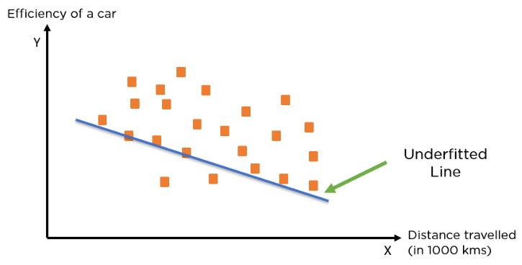
Overfitting and Underfitting
Underfitting

Slide 10
Overfitting and Underfitting
Underfitting
Reasons for Underfitting
Data used for training is not cleaned and contains noise (garbage values) in it
The model has a high bias
The size of the training dataset used is not enough
The model is too simple
Ways to Tackle Underfitting
Increase the number of features in the dataset
Increase model complexity
Reduce noise in the data
Increase the duration of training the data

Slide 11
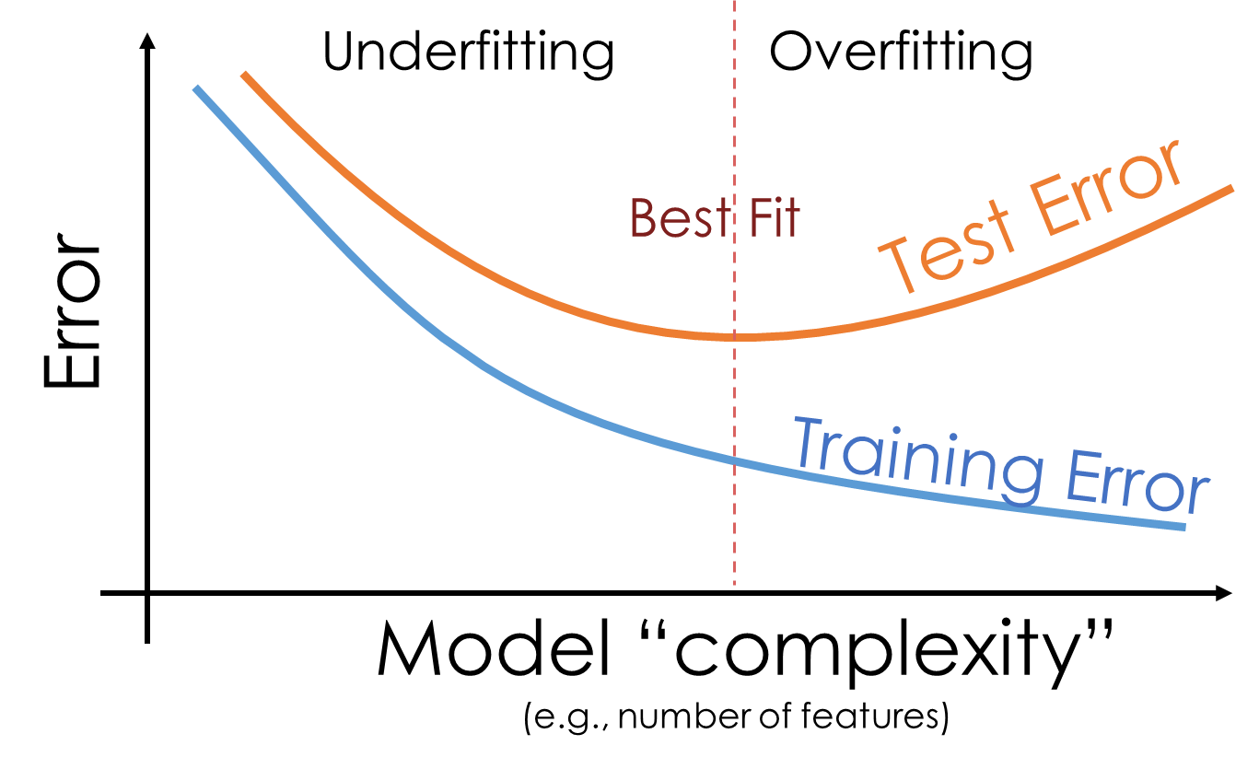
Overfitting and Underfitting

Slide 12
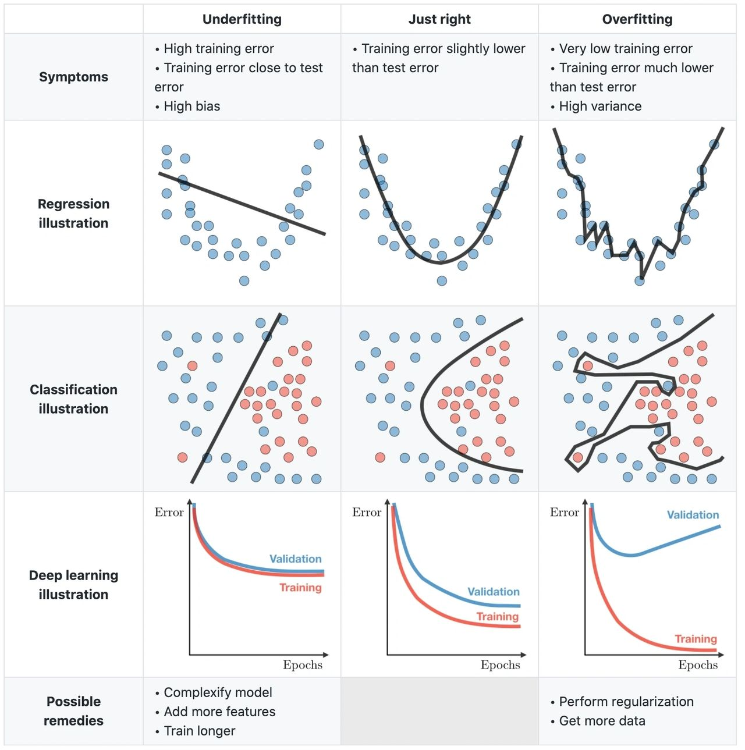
Overfitting and Underfitting

Slide 13
Overfitting and Underfitting
What is bias and variance in machine learning?
Bias:
Bias is the error between average model prediction and ground truth
It tells us the capacity of the underlying model to predict the values.
Low Bias: Suggests less assumptions about the form of the target function.
High-Bias: Suggests more assumptions about the form of the target function.
Variance:
Variance is the amount that the estimate of the target function will change if different training data was used.
The variance of estimated function tells us how much the function can adjust to the change in dataset.
Machine learning algorithms that have a high variance are strongly in influenced by the specifics of the training data.
Low Variance: Suggests small changes to the estimate of the target function with changes to the training dataset.
High Variance: Suggests large changes to the estimate of the target function with changes to the training dataset.

Slide 14
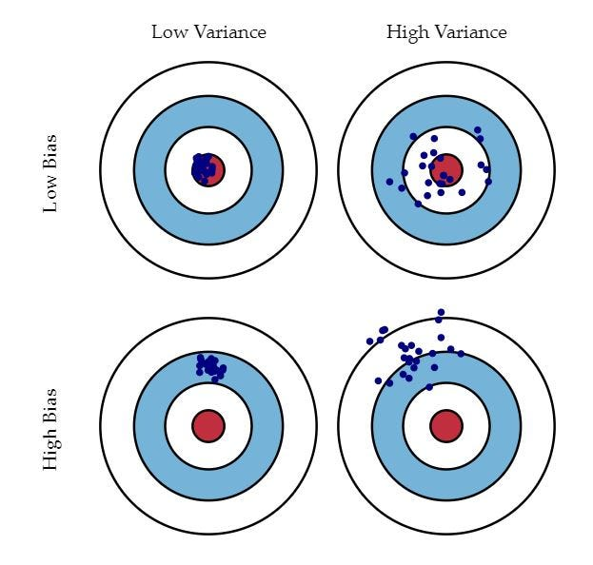
Overfitting and Underfitting

Slide 15
Cross Validation

Slide 16
Cross Validation
A general procedure for estimating the true error of a predictor
The data is split into two subsets:
Training Set used only to find the right predictor
Test Set used to report the prediction error of the algorithm
These sets must be disjoint!
The process is repeated several times, and the results are averaged to
provide error estimates.

Slide 17
Cross Validation
Several algorithm for Cross Validation:
the holdout (simple train-test split)
K-fold Cross-validation
Stratified K-Fold cross-validation

Slide 18
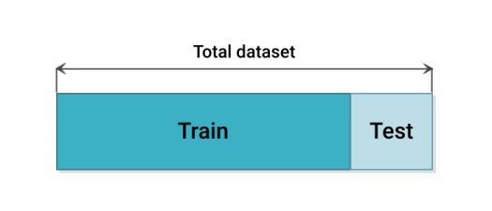
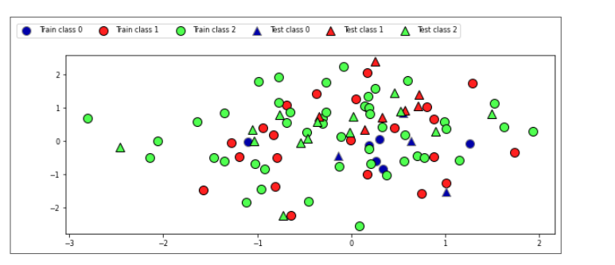
Cross Validation
the holdout (simple train-test split)
Randomly split data (and corresponding labels) into training and test set (e.g. 75%-25%)
Train (fit) a model on the training data, score on the test data

Slide 19
Cross Validation
K-fold Cross-validation
Each random split can yield very different models (and scores)
e.g. all easy (of hard) examples could end up in the test set
Split data into k equal-sized parts, called folds
Create k splits, each time using a different fold as the test set
Compute k evaluation scores, aggregate afterwards (e.g. take the mean)
Examine the score variance to see how sensitive (unstable) models are
Large k gives better estimates (more training data), but is expensive

Slide 20
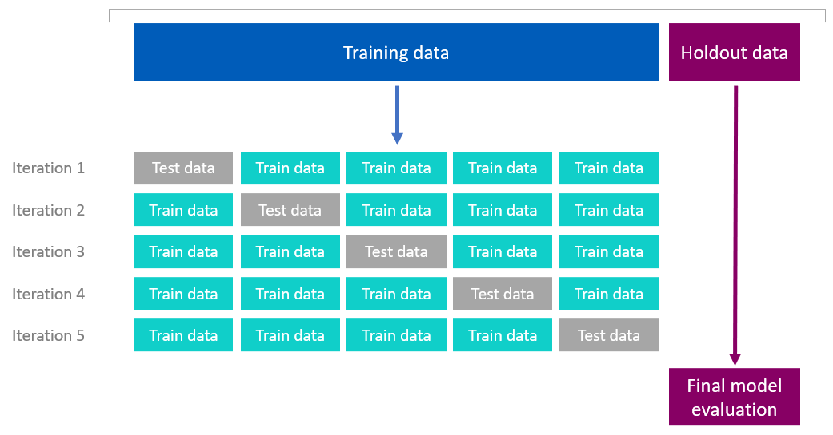
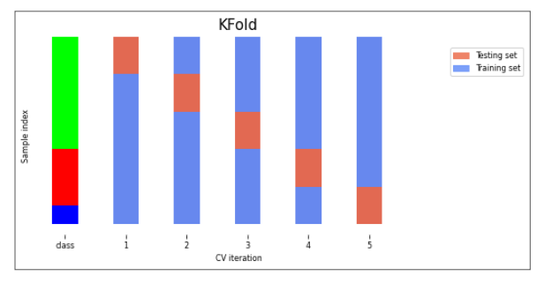
Cross Validation
K-fold Cross-validation

Slide 21
Cross Validation
Stratified K-Fold cross-validation
If the data is unbalanced, some classes have only few samples
Likely that some classes are not present in the test set
Stratification: proportions between classes are conserved in each fold
Order examples per class
Separate the samples of each class in k sets (strata)
Combine corresponding strata into folds

Slide 22
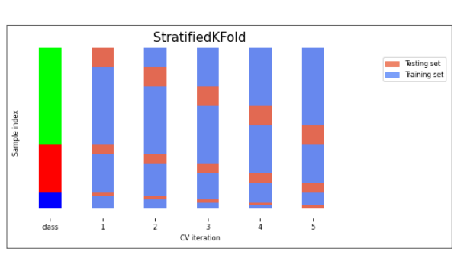
Cross Validation
Stratified K-Fold cross-validation

Slide 23
Regularization

Slide 24
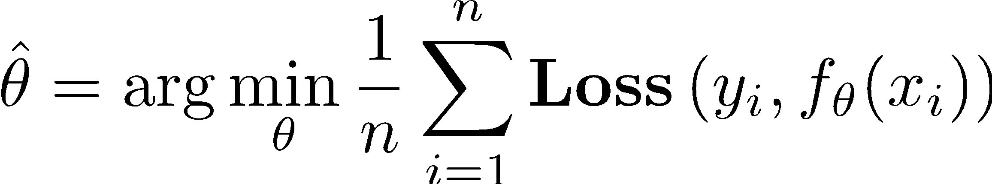
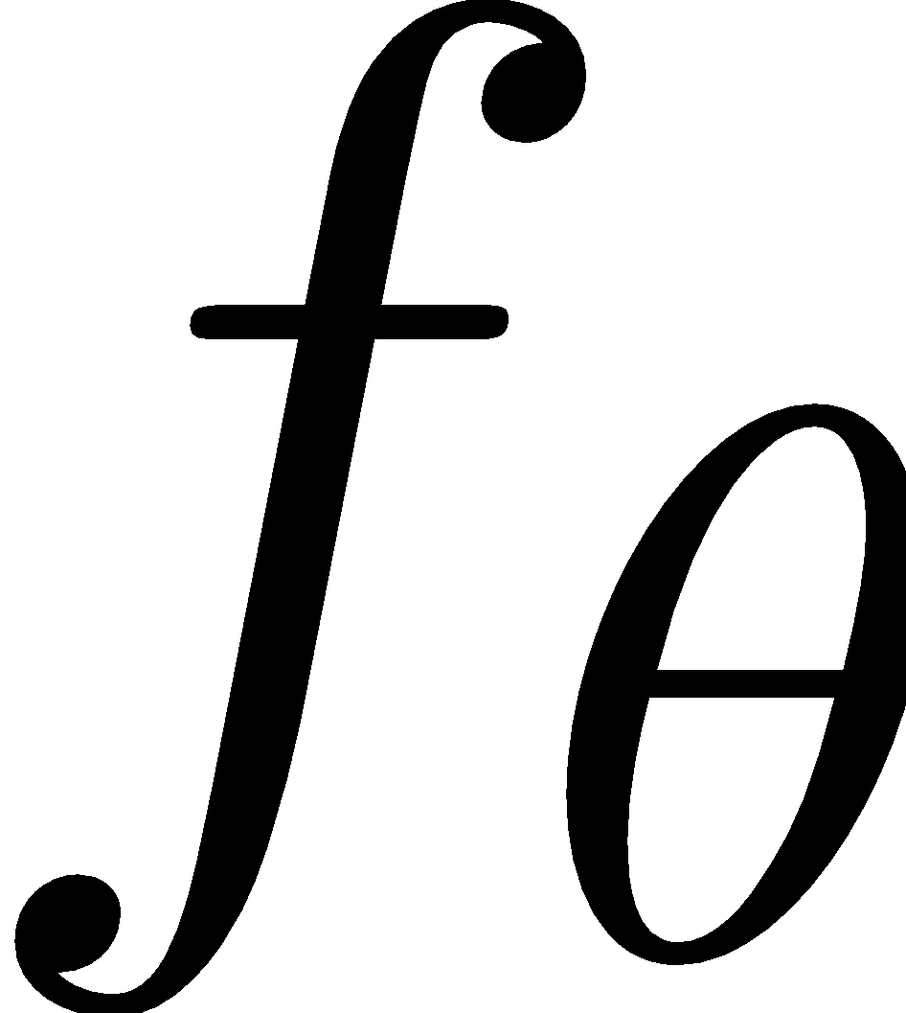
Regularization
Regularization refers to techniques used to calibrate machine learning models to minimize the adjusted loss function and avoid overfitting or underfitting.
The Basic Idea:
Such that:
does not “overfit”
Can we make this more formal?

Slide 25
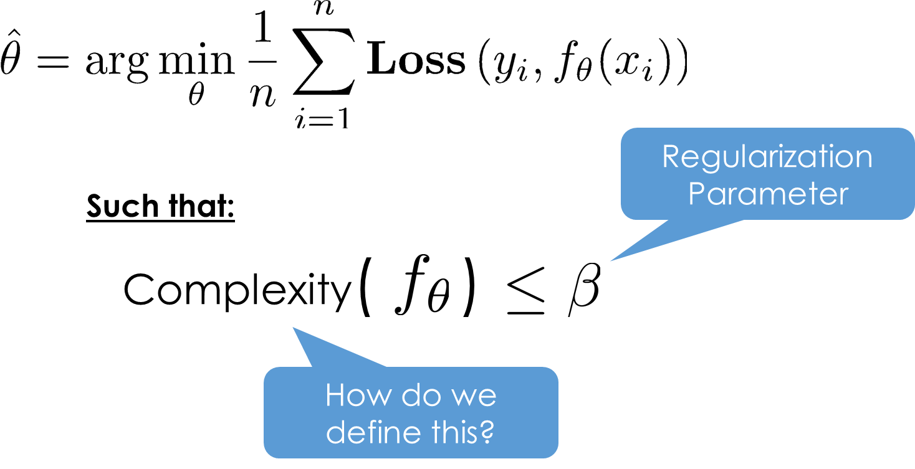
Regularization
The Basic Idea:

Slide 26
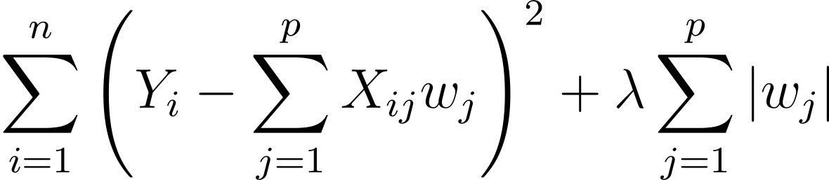
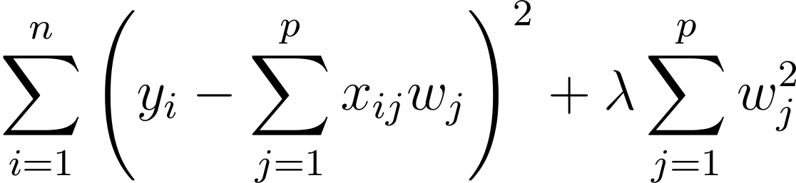
Regularization
Two widely used regularization techniques used to address overfitting are L1 and L2 regularization.
L1 Regularization, also called a lasso regression, adds the “absolute value of magnitude” of the coefficient as a penalty term to the loss function.
L2 Regularization, also called a ridge regression, adds the “squared magnitude” of the coefficient as the penalty term to the loss function.
Ridge Regression performs regularization by reducing the coefficients present.
Penalty Term
Penalty Term

Slide 27
References

Slide 28
References
Bismal, A. (2023, February). The Complete Guide on Overfitting and Underfitting in Machine Learning. Simplilearn.Com. https://www.simplilearn.com/tutorials/machine-learning-tutorial/overfitting-and-underfitting
Choudhary, A. S. (2022, August 29). Regularization in Machine Learning. Analytics Vidhya. https://www.analyticsvidhya.com/blog/2022/08/regularization-in-machine-learning/
Maheshwari, K. (2021, September 8). Bias & Variance in Machine Learning. Analytics Vidhya. https://medium.com/analytics-vidhya/bias-variance-in-machine-learning-1bfbefd4285d
Nagpal, A. (2022, January). L1 and L2 Regularization Methods, Explained. Builtin. https://builtin.com/data-science/l2-regularization
Precup, D. (2017). Overfitting. Regularization. COMP-652 and ECSE-608. https://www.cs.mcgill.ca/~dprecup/courses/ML/Lectures/ml-lecture02.pdf
Vanschoren, J. (n.d.). Model Selection. Machine Learning for Engineers. https://ml-course.github.io/master/04%20-%20Model%20Selection.pdf

